Slide 1
Project Portal Workflow

Slide 2
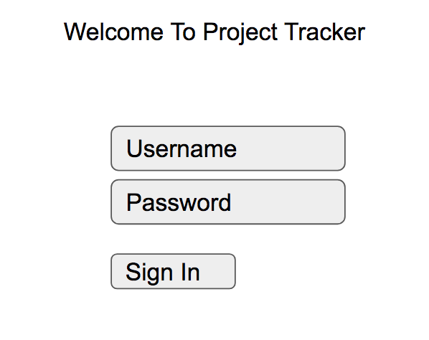
Login
2 Personas: Faculty and Student
Faculty would have the privileges to perform the CRUD operations
Student would have
CRUD privileges on their own projects
Read-only access to all the other projects

Slide 3
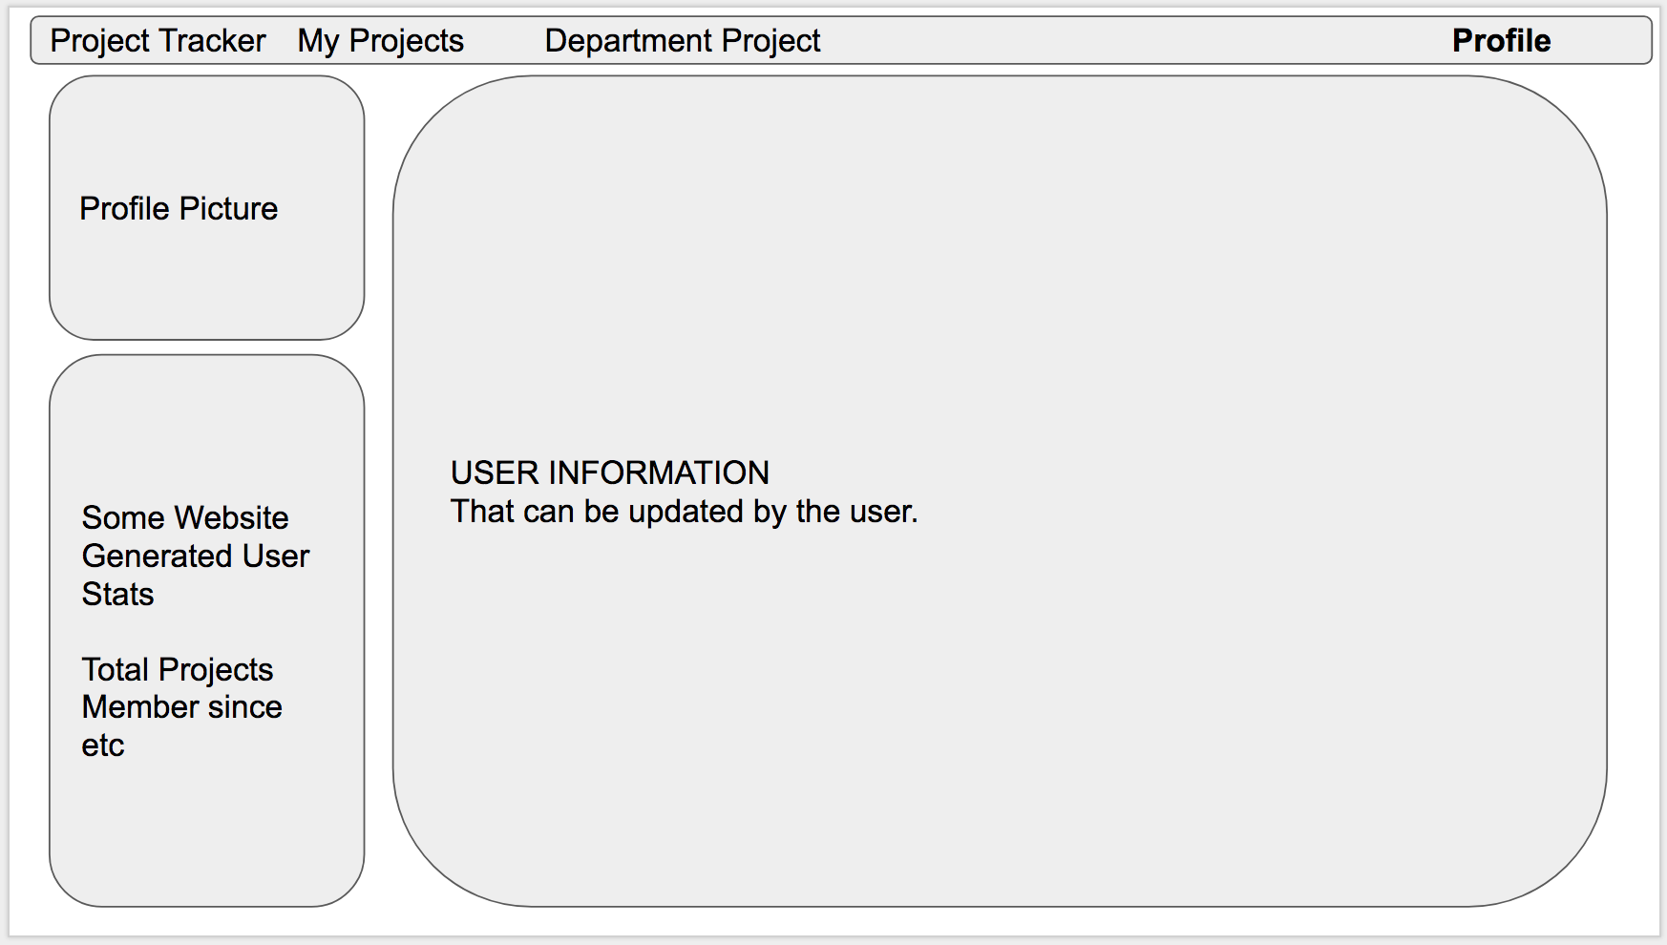
Primarily 3 tabs: Profile, Users Project, Search Project

Slide 4
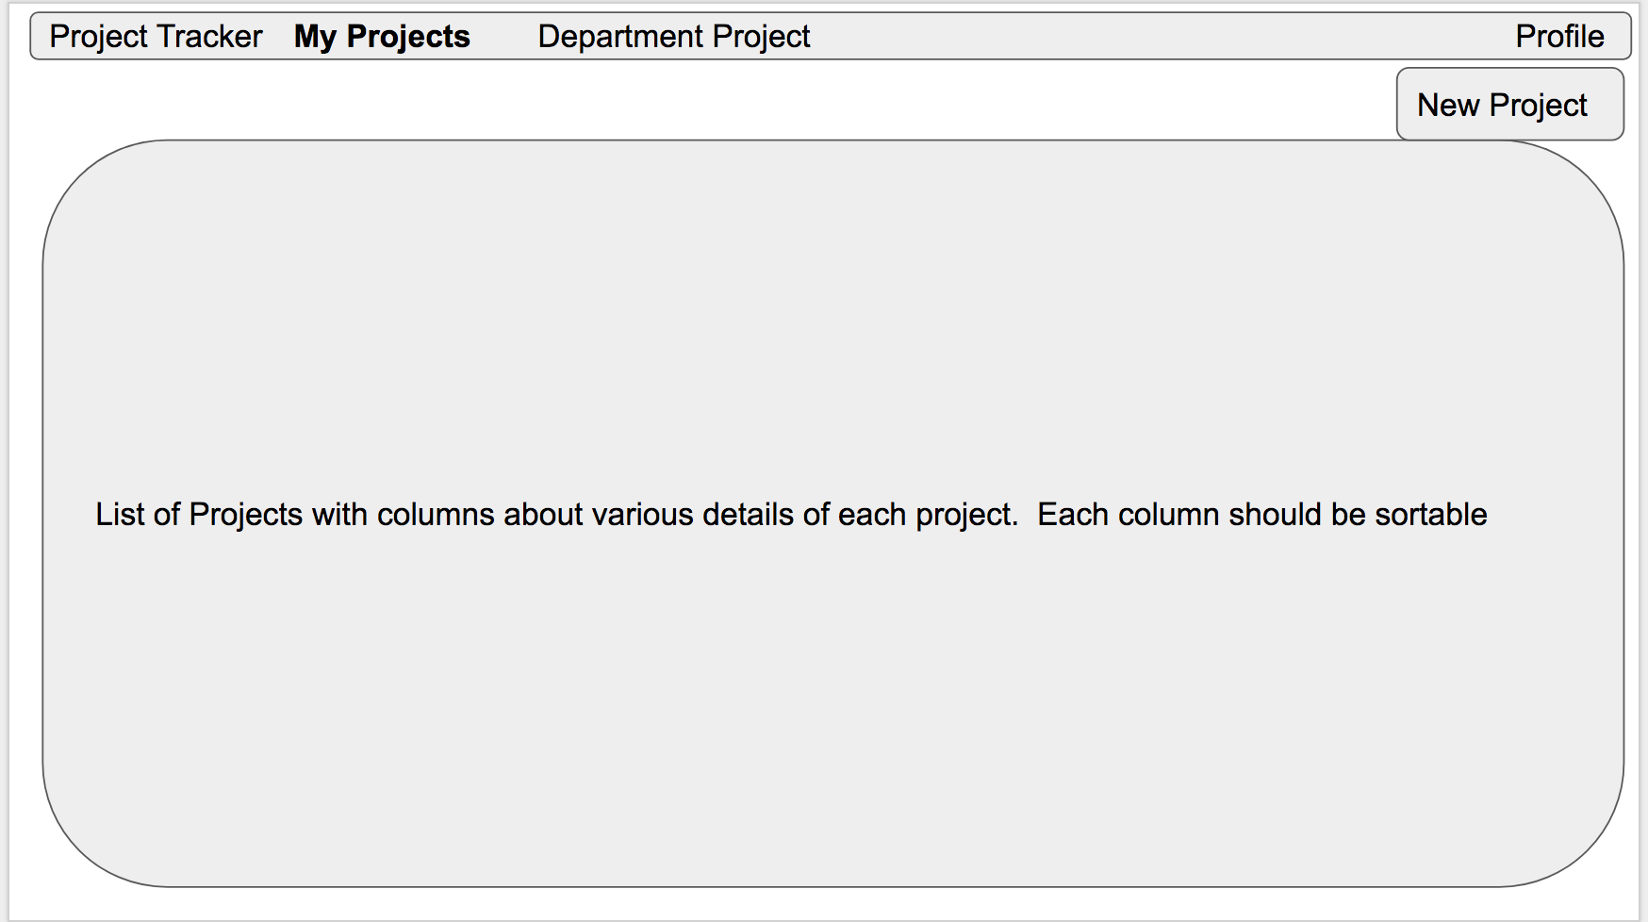
Primarily 3 tabs: Profile, Users Project, Search Project

Slide 5
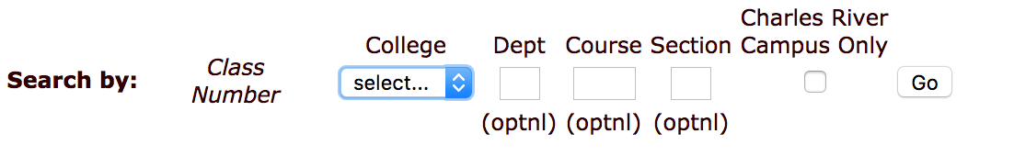
Primarily 3 tabs: Profile, Users Project, Search Project
TBD
(Maybe) Google style Searchable by ‘String’ across all the fields
Provision for additional filters based on AND, OR conditions
Additional filters based on Dept, Project, Technology used
(Maybe)

Slide 6
Project Detail View
Attributes for a project:
Project Name : Project Portal
Project Summary: Portal to host students projects and white papers
Technology Used / Stack Used: MongoDB, Express, Node.js, Angular.js
Link to Repository: https://github.com/cs673-team-silver-serpent/project
Link to the Project Tracker: https://www.pivotaltracker.com/n/projects/2147318
Comments/References/Learnings:
Contributors: Ben, Chad, Parker, Andy and Kanishq
Labels (keywords, Tags): #portal, #javascript, #MEAN, #AWESOME
Link to Demo:
Create Date: Auto populated when a new project is submitted

Slide 7
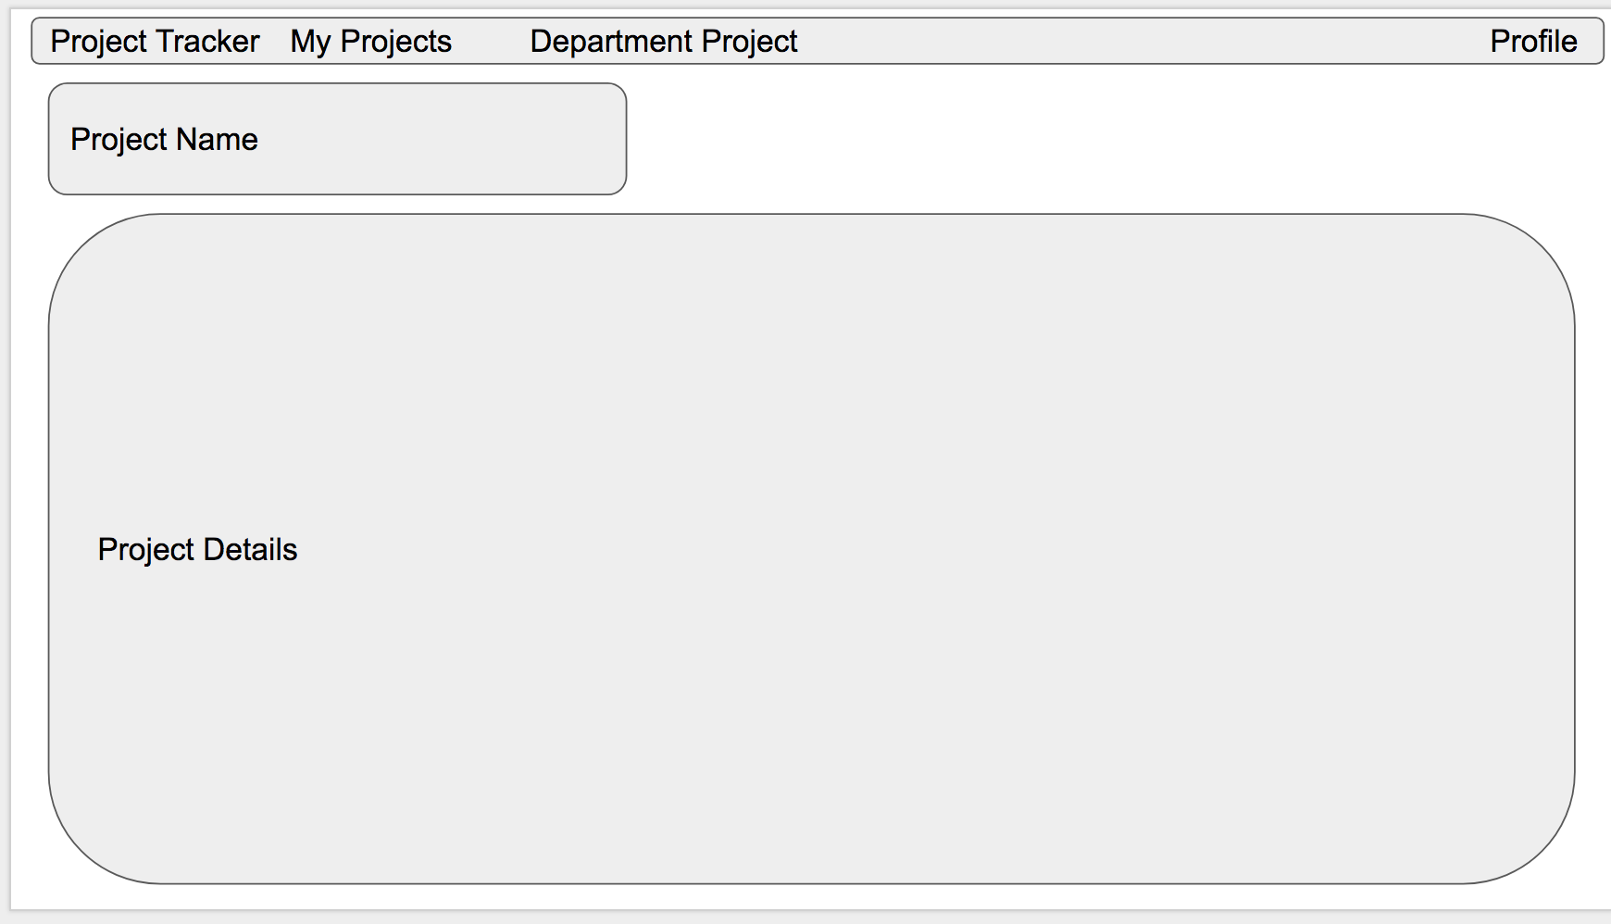
Project Details

Slide 8
Additional Requirements
Option to favorite the project, so that its gets added to My Profile Favorite
Print option for the search
Highlight the search string in the result
Saving of Query/ Export
Paging for result set more than 100

Slide 9
Iteration 1

Slide 10
Architecture Overview
Single Page Application
Technologies used: MEAN stack
M – Mongo is a No SQL database program which processes JSON like documents. Mongo DB with mongoose helps with data validation to ensure the schema is consistent while inserting/updating/finding documents. It is used for modelling
E – ExpressJS is the web development framework used in Node js for building APIs and Web application. It helps manage everything from routes, to handling requests and views
A – Angular It is used for the front end web development.
N – Node JS is a backend web development framework used for creating network based server side web applications

Slide 11
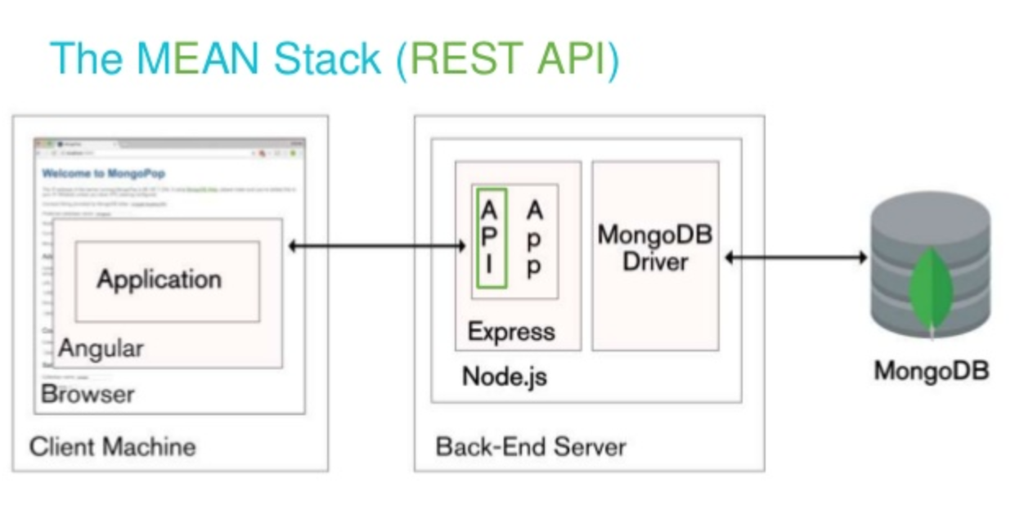
Architecture Overview

Slide 12
Model – View - Controller
When a user performs an action on the Front end (which is our View), it triggers an API call which is sent to the backend for servicing.
Say a user clicks on the “Add Project”, which sends a request to the backend with a request body
This request is sent to the backend controller via REST which is further redirected based on the routes and validation as defined in the controller.

Slide 13
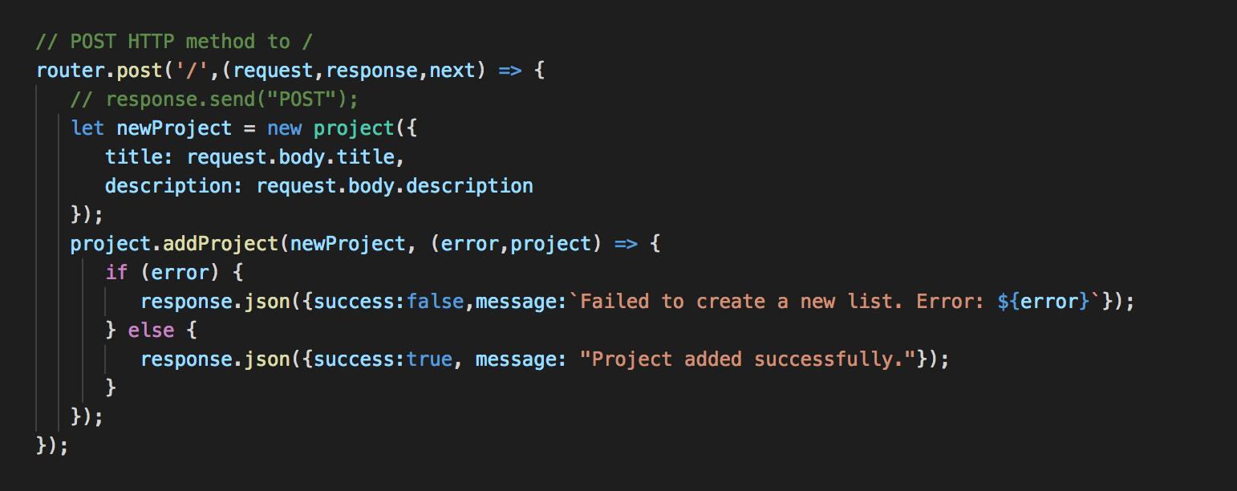
Model – View - Controller
When a request is sent by the Front End (which is the View), it is received by the controller which has the details of how a particular request needs to be handled Or routed. Example: Add a new Project

Slide 14
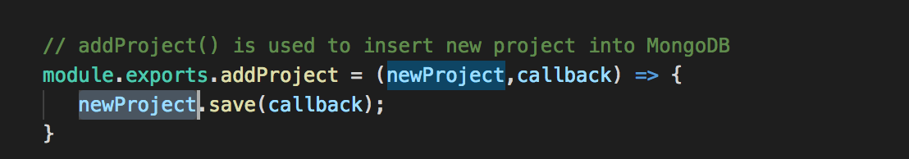
Model – View - Controller
The request received by the Controller is routed to the Model where the actual implementation of that requested call is defined. Example:

Slide 15
Why are we using what we are using?
MEAN stack helps create a full stack development based on java script
Works very well for a Single Page Applications
Mongoose with Mongo, helps with a layer of abstraction over pure data. It also helps with data validation to ensure the schema is consistent while inserting/updating/finding documents
Angular is an open source web app framework developed and maintained by Google. It modified the page DOM directly making it faster compared to KnockoutJS

Slide 16
Key Highlights of this Sprint

Slide 17
User Authentication & Session Management
The user enters the email and the username
The password is passed to the hash function (SHA256 Hashing Algorithm) to create the hash which is then matched with the saved password hash in the database.
If the password hash and the email combination matches with that present in the database then the user is authenticated.
When the user is authenticated a new session for the user is created.
A user is then returned in the form of a Json object an the user is signed in with that object.

Slide 18
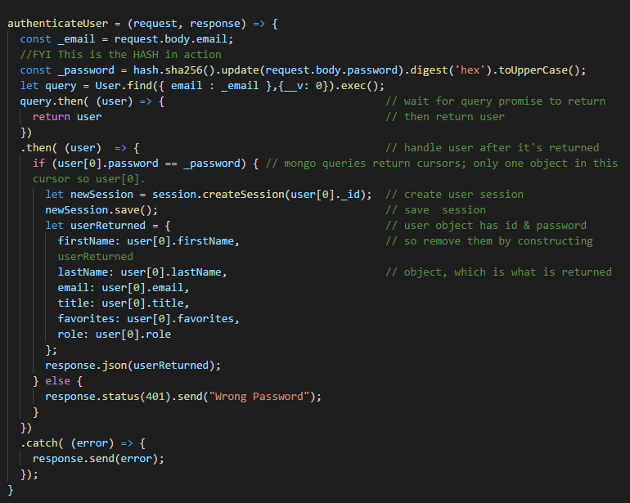
User Authentication - Algorithm

Slide 19
UI Enhancements/Changes
The projects has the following new features
Updated ‘Login’ page
Fixed page redirections
New ‘Display Projects’ page design that will show details of one project.
New ‘Create Account’ page for registering new user
Guest Login now available

Slide 20
Test coverage & automation
Tests Performed:
Test for successfully finding user by ‘First Name’, partial ‘First Name’ & partial ‘Last Name’.
Check if the should not find a user with wrong ‘First Name’.
It should not find a user with wrong ‘First Name’.
Test for POST request a new user with all required fields.
Adding user with missing ‘First Name’ should fail.
Adding user with missing ‘Last Name’ should fail.
Adding user with missing email should fail.
Adding user with empty password or password less that 8 characters should fail.

